Slide 1

Final presentation Customization of RISCV code and backend design of a RISCV processor - 7880
By: Omar Sharafy, Muhammad Biadsy
Instructor: Amnon Stanislavsky
VLSI Lab
Winter & spring Semesters 2024/25

Slide 2
Agenda
Background.
Project definition and goals.
Alternative solutions.
Architectural design of the selected solution.
Back-end flow.
Results

Slide 3
Background & Motivation
RISC-V is a simple architecture which is being taught in “digital systems & computer structure”.
The purpose of this project is to take the pipelined version of RISC V presented in the course and prepare it for a potential fabrication, while:
1) making other changes that will reduce the required area & power memories consume (by using Tower SRAMs).
2) create an external memory loading method.
3) adding debugging capabilities that allow access to internal registers. after fabrication.
The original code needs to be modified to allow the backend stages to be executed correctly.

Slide 4
Goals
Replacing
Replacing non-synthesizable memory-loading techniques with an external interface.
Upgrading
Upgrading inefficient course-provided memories to compact, compiled memories, which are more power and size effective.
Adding
Adding debug capabilities for accessing internal registers post-fabrication.
Performing
Performing a back-end physical design flow, while optimizing frequency by refining Verilog code.

Slide 5
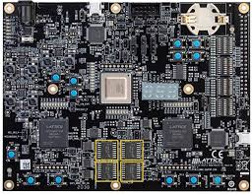
Alternative solutions
the RISC-V Processor that we work with can utilize FPGA memories and the control unit as a debug tool to monitor internal signals, while leveraging the initial lines of code to load the desired memory into the compiled memory.
Although this solution is possible, FPGA memories are not effective size or power wise.

Slide 6
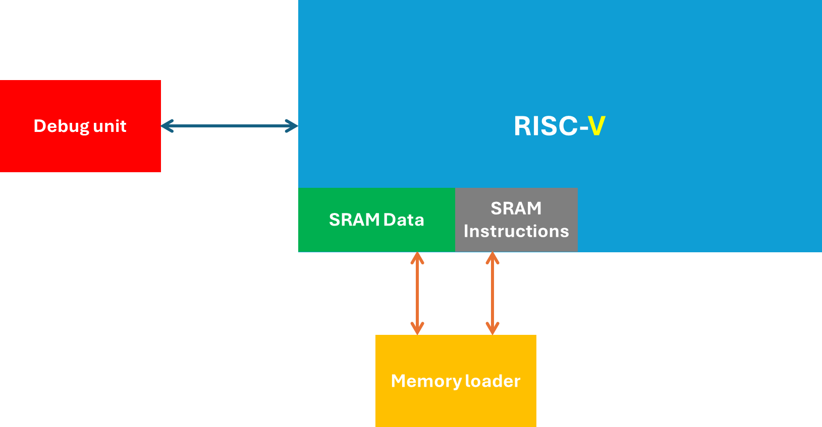
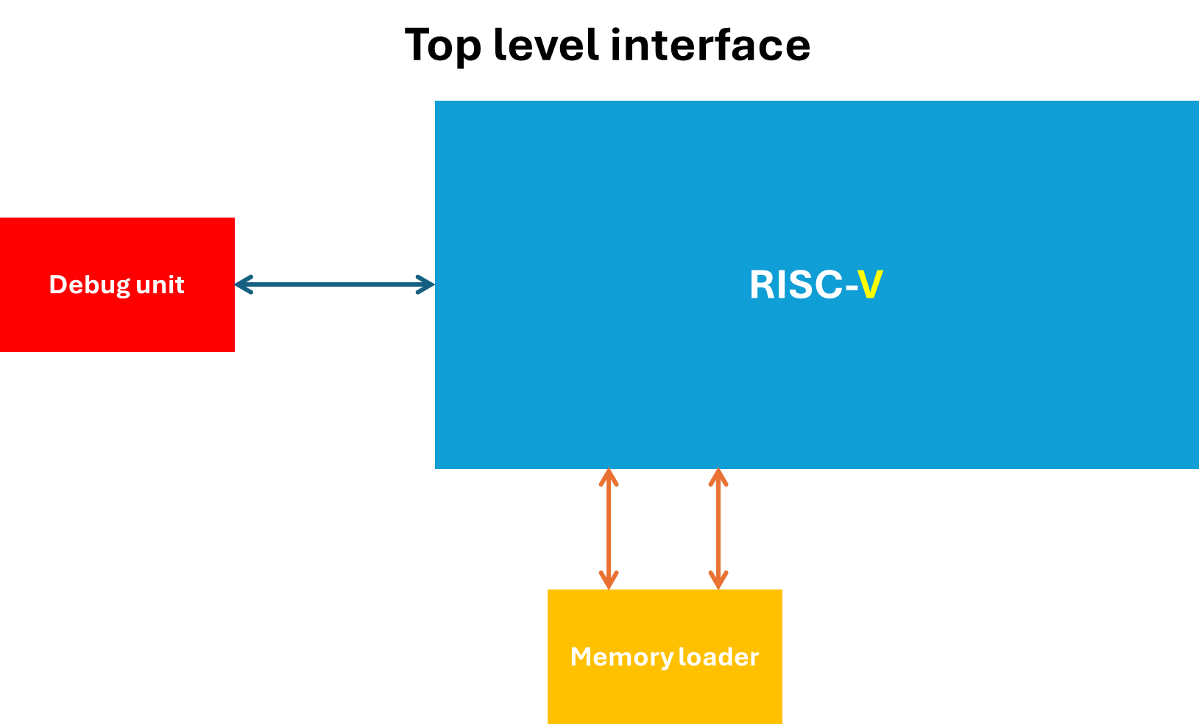
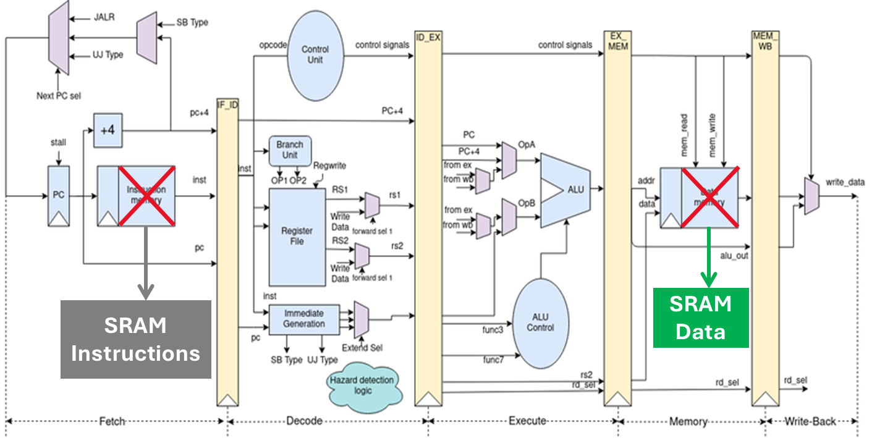
Architectural design of the selected solution memory replacement

Slide 7
Architectural design
Using SRAM memories, which are area & power efficient, allowing simultaneous read and write operations to multiple addresses.
Create a dedicated debugging unit, separate from the control unit. to provide additional debugging capabilities.
Add 2 input pins, creating a memory loading flow.

Slide 8
Architectural design of the selected solution memory loading mechanism
adding 2 input pins (one for data, one for instructions), and taking advantage of the fact that Tower S-RAMs can write to 2 different addresses in parallel.
Restart
Loading data & instructions
Processor
running
End
Debug

Slide 9
Master design – FPJA memory problem & solution
Problem:
Compilation failed - FBJA memory is not detected by the synthesis tool, causing the design to fail compilation.
Solution:
Virtual FBJA memory – altsyncram.v file.

Slide 10
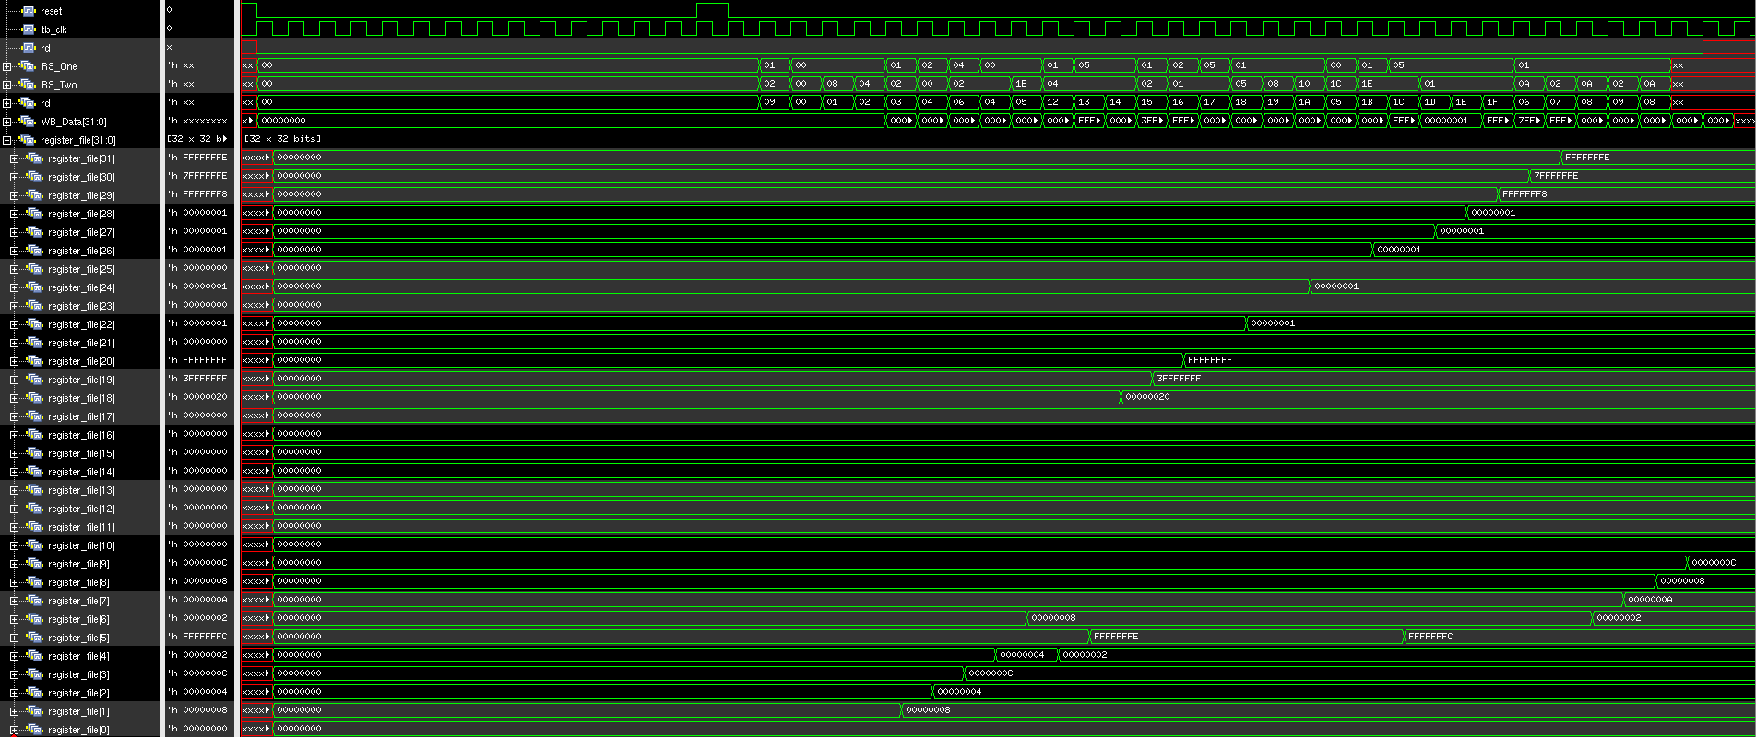
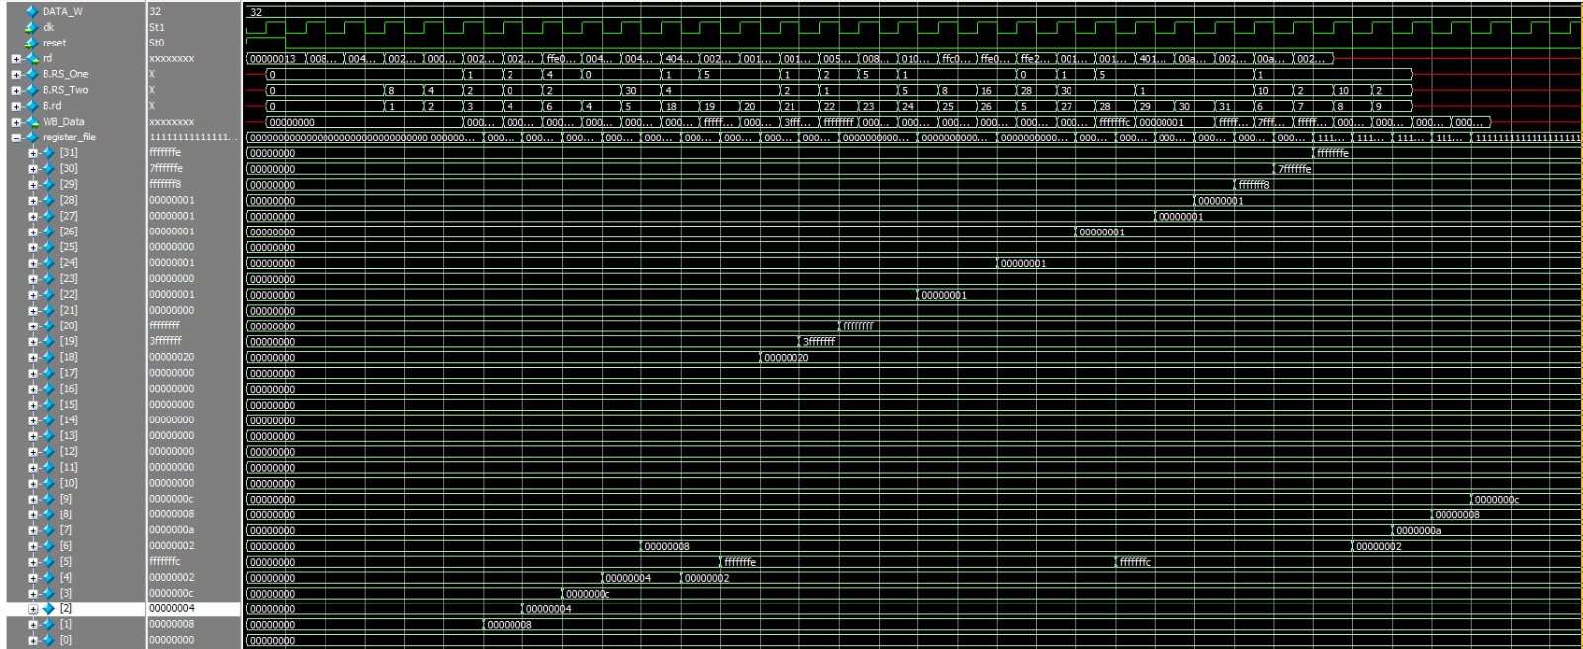
Master design - Simulation with virtual FBJA memory
Our design simulation with virtual FBJA memory
Master design simulation

Slide 11
Architectural design of the selected solution instruction memory
Data Size: 2048 bits.
I/O Width: 32 bits (4 bytes, corresponding to the instruction length).
Memory Access: Simultaneous read/write operations at two addresses in parallel.
8
8
32
32
8
8

Slide 12
Architectural design of the selected solution data memory
Write/Read Logic
Write/Read control
Data Size: 4096 bits X 4(16,384 bits total).
I/O Width: 8 bits (1byte, RISC-V reads/writes in bytes).
Memory Access: Simultaneous read/write operations at two addresses in parallel.
8
8
8
8
32
32
8
8
8
8
Reorder Adress logic
Write/Read Address
Write/Read Address

Slide 13
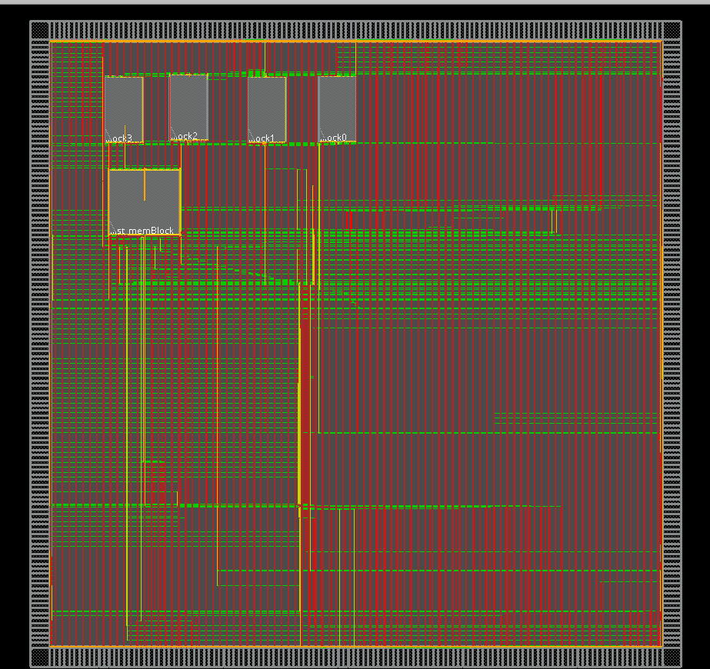
Architectural design of the first solution Debug unit
All relevant debug outputs were connected directly to the RISC-V module.
Resulting physical design layout included numerous I/Os & big design.

Slide 14
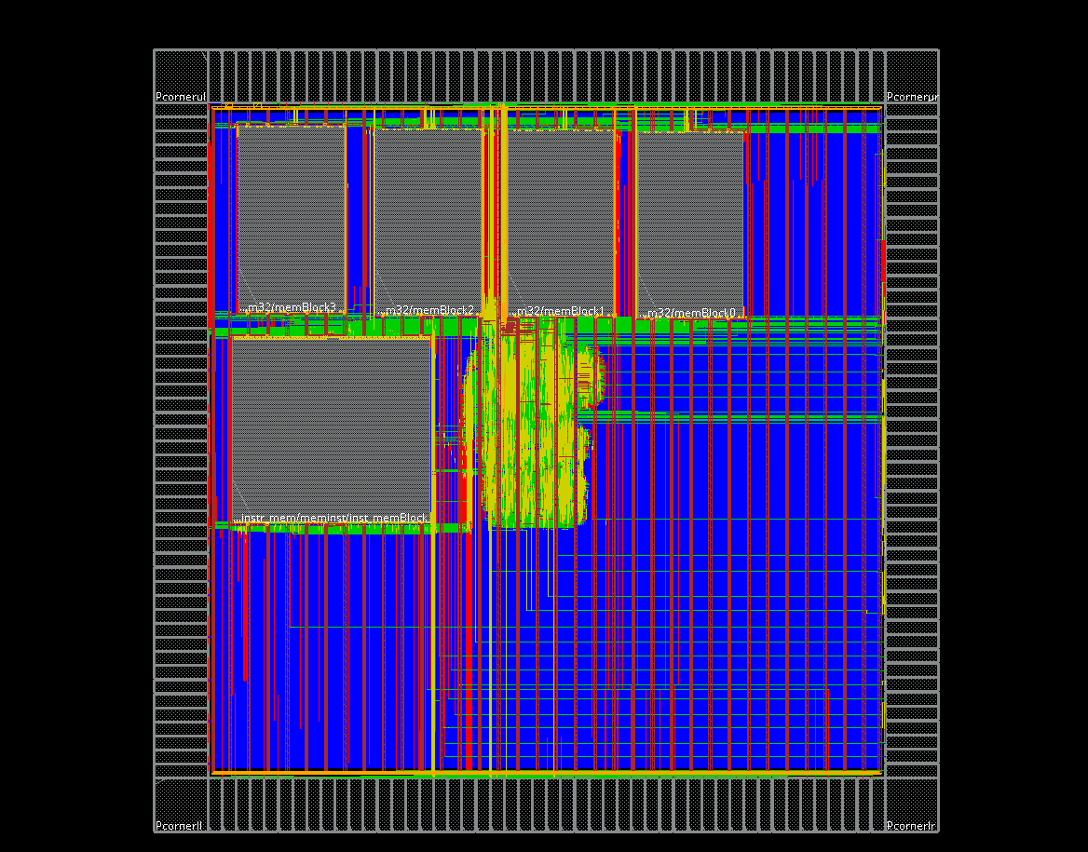
Architectural design of the selected solution Debug unit
29 circuit points across various pipeline stages and control/data paths were connected to a 32-input multiplexer system.
This externally controlled MUX allowed users to select and observe specific signals dynamically, enabling real-time inspection of key Datapath and memory elements such as ALU results, fetched opcodes, register values, memory addresses, and read/write data.
Physical Design – Layout:
Pin count reduced by approximately 250.
Resulted in a smaller design.

Slide 15
Architectural design of the selected solution Debug unit
Sel | Output | Description
0 | {25'b0, opcodeFetch} | Opcode from Fetch stage (padded to 32 bits)
1 | {25'b0, opcodeDecode} | Opcode form the operation in Decode stage (padded to 32 bits)
2 | {25'b0, opcodeExecute} | Opcode form the operation in Execute stage (padded to 32 bits)
3 | {25'b0, opcodeMem} | Opcode form the operation in Memory stage (padded to 32 bits)
4 | {25'b0, opcodeWb} | Opcode form the operation in Writeback stage (padded to 32 bits)
5 | {25'b0, Funct7Decode_Dout} | Funct7 form the operation in Decode stage (padded to 32 bits)
6 | {29'b0, Funct3Decode_Dout} | Funct3 form the operation in Decode stage (padded to 32 bits)
7 | {25'b0, Funct7Execute_Dout} | Funct7 form the operation in Execute stage (padded to 32 bits)
8 | {29'b0, Funct3Execute_Dout} | Funct3 form the operation in Execute stage (padded to 32 bits)
9 | {25'b0, Funct7Mem_Dout} | Funct7 form the operation in Memory stage (padded to 32 bits)
10 | {29'b0, Funct3Mem_Dout} | Funct3 form the operation in Memory stage (padded to 32 bits)
11 | {25'b0, Funct7Wb_Dout} | Funct7 form the operation in Writeback stage (padded to 32 bits)
12 | {29'b0, Funct3Wb_Dout} | Funct3 form the operation in Writeback stage (padded to 32 bits)
13 | {23'b0, PC_debug} | Program Counter (padded to 32 bits)
14 | FAmux_Result_debug | Forwarding A MUX result
Sel | Output | Description
15 | SrcB_debug | Source B debug
16 | {31'b0, PcSel_debug} | PC select signal (padded to 32 bits)
17 | {23'b0, BrPC_debug} | Branch PC (padded to 32 bits)
18 | ALUResult_debug | ALU result
19 | {28'b0, Operation} | ALU operation code (padded to 32 bits)
20 | {23'b0, addr} | Memory address (padded to 32 bits)
21 | wr_data | Data written to memory
22 | rd_data | Data read from memory
23 | {31'b0, wr} | Register written to number (padded to 32 bits)
24 | {31'b0, rd} | Register read from number (padded to 32 bits)
25 | {27'b0, reg_num} | Register number (padded to 32 bits)
26 | reg_data | Data read from register
27 | {31'b0, reg_write_sig} | Register writes enable signal (padded to 32 bits)
28 | WB_Data | Write-back data

Slide 16
Code & design changes
The original design had FPGA memories integrated into it as the system memory, which created some challenges.
We had to integrate some files from FPGA libraries to compile and run the design.
The design provided incorrect results whenever running commands with an undeviable-by-4 address, and the fact that the FPGA memories operated upon the clock falling (not rising).
During the process of replacing the original memory blocks with Tower SRAMs, modifications were made to both the logical and timing aspects of the design, among the key updates, flip-flops were strategically inserted at critical points in the data path, and in some instances, sequential logic was restructured into purely combinational logic to better align with the new memory interface timing system.
Throughout this transition, careful attention was given to preserve all existing functionalities of the system, ensuring that no other parts of the design were adversely affected by the modifications.

Slide 17
Back-end flow:
Using Synopsys Design Vision tool & TSMC TSL 108 Tower Design Kit for Synthesis flow, converting the RTL design into a gate-level netlist that matches the target manufacturing process.
Using Cadence Innovus tool & TSMC TSL 108 Tower Design Kit for a short layout flow, transforming a synthesized Verilog design into a complete physical chip layout, while trying to maximize the working frequency.
Using PrimeTime Tool to verify and debug timing issues, to reach maximum working frequency.

Slide 18
Synthesis flow :
Using Synopsys Design Vision tool & TSMC TSL 108 Tower Design Kit for Synthesis flow, converting the RTL design into a gate-level netlist that matches the target manufacturing process.
To create an efficient gate-level netlist, we had to parameterize some general-use modules that we integrated into the design (especially muxes), while always checking the design after compile to ensure area and timing efficacy.

Slide 19
Layout flow :
Using Cadence Innovus tool & TSMC TSL 108 Tower Design Kit for a short layout flow, transforming a synthesized Verilog design into a complete physical chip layout, while trying to maximize the working frequency.
Floorplan & Power and ground pins were defined to setup the chip and enable it’s power ring, Standard cells, including Tower SRAMs, were automatically placed with optimization for timing and congestion.
Clock Tree Synthesis (CTS) followed, creating a balanced network with 1.3 ns skew for proper synchronization (with a test and try to reduce clk cycle policy).
Finally, after power routing was completed, full signal routing was carried

Slide 20
STA Check:
Using PrimeTime tool & Tower Design Kit, for timing violations in the design & trying to achieve maximum working frequency.
By using slightly modified scripts (adaptive to our design and libraries), PrimeTime verifies setup and hold constraints, path delays, and critical corner cases.
This process enables us to debug timing issues and adjust the operating frequency after each design/clock change.

Slide 21
Challenges & problems
Design Size was getting a lot bigger due to the initial debug unit planning, creating a high-density & complex design.
-We had to re-plan, and used a common solution used in the real world, adding a mux to the debug unit outputs, reducing the design size by ~ %60.
Inconsistencies between tools used in different back-end manuals, This limitation was shown during our attempt to use PrimeTime (as guided in the long manual) within a project originally structured using the short manual, causing us to create a new script ( with Goel help).

Slide 22
Results
Maintained RISC-V operations.
Added support for full memory space access in memory operations (previously, only addresses divisible by 4 were supported).
A Clock Tree with 1.3ns slack.
166.67 MHz working frequency.

Slide 23
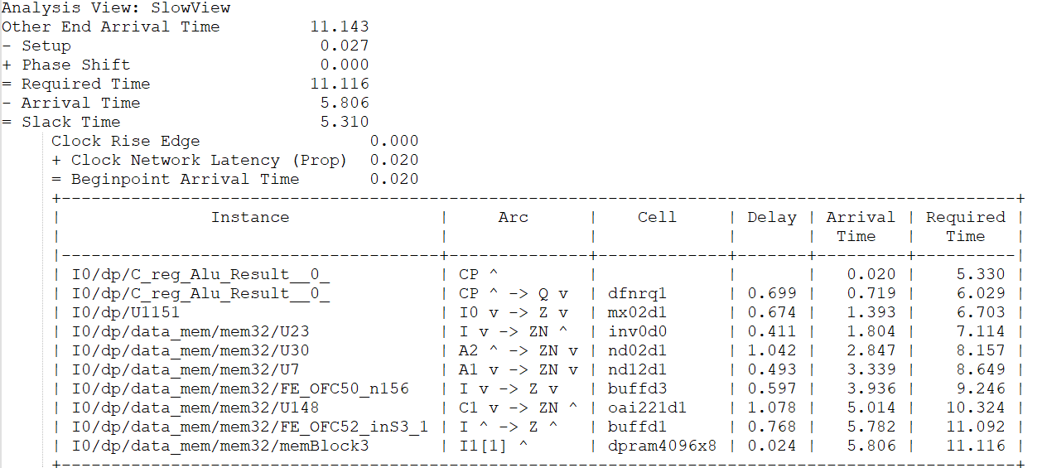
Results
One of critical paths, that was created due to our memory & design changes.
starts at the ALU and ends at memblock3, which is the furthest from the RISC-V core in the physical layout.

Slide 24
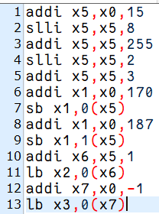
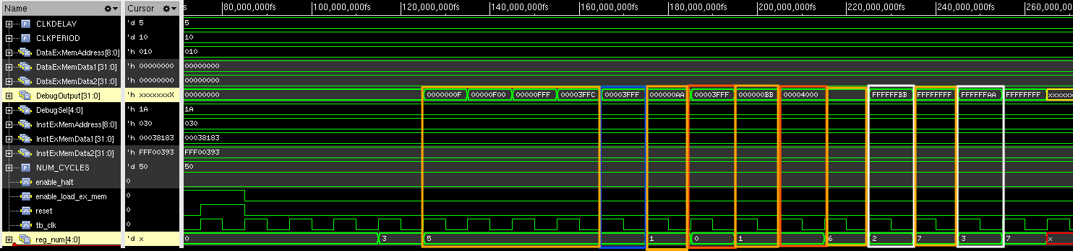
Simulation – memory write/read
Regdata== 5b’11010

Slide 25
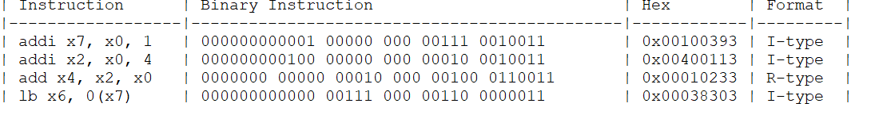
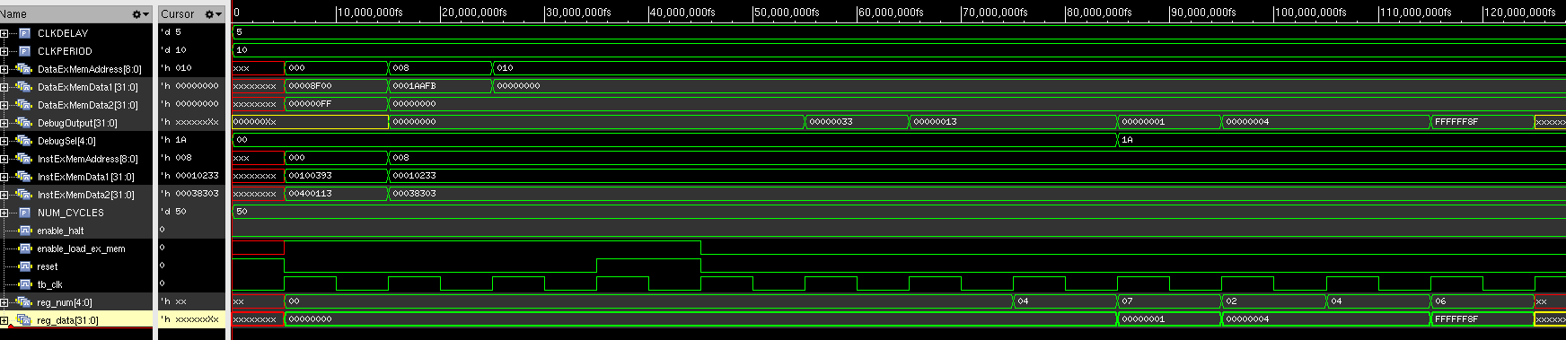
Simulation instruction load & debug select
Opcode fetch == 5b’00000
Regdata== 5b’11010

Slide 26
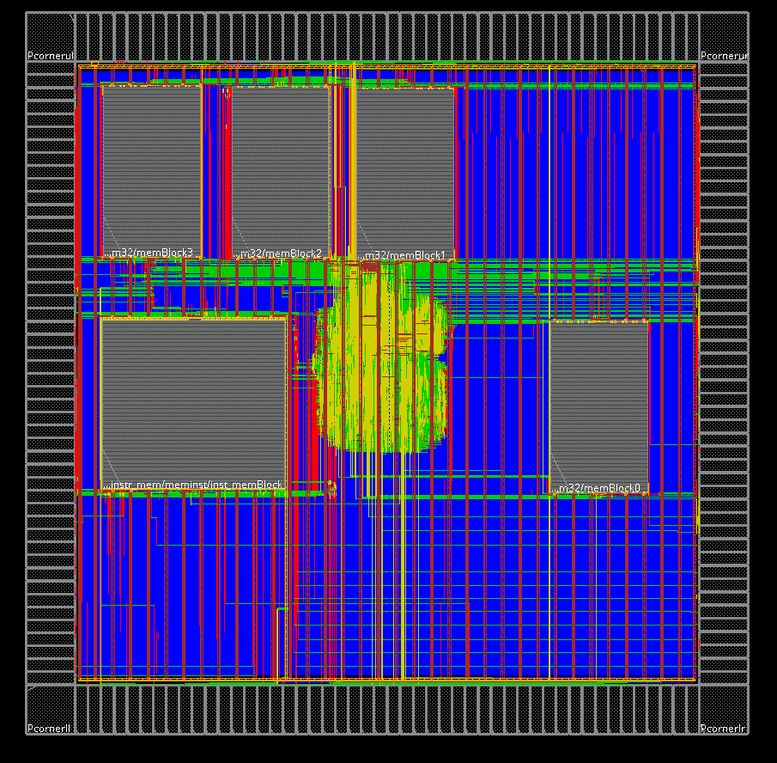
Thank You!

